Slide 1
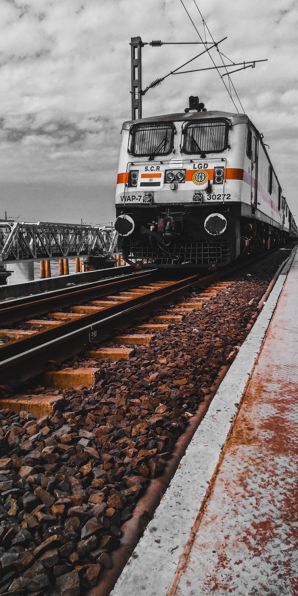

Migration of Indian Railway System (IRS) to AWS
Team Members
Gunjan C
Subham S
Soorya A
Harish S
Sandeep S

Slide 2
Indian Railway System
The Indian Railway System (IRS) is one of the largest and most complex railway networks in the world, operating over 115,000 km of track and serving 1.3 billion passengers annually.
6
3
4
5
1
2

Slide 3
Migration of IRS to AWS
Why Migrate?
Aging infrastructure
Modernization needs
Benefits:
Improved Efficiency
Increased Reliability
Enhanced Security
2
6
3
4
5
1

Slide 4
AWS Services utilized for migration
Overview of AWS Services for Migration:
Amazon EC2 (Elastic Compute Cloud)
Amazon RDS (Relational Database Service)
Amazon S3 (Simple Storage Service)
AWS Migration Hub
AWS Data Sync
4
2
6
3
5
1

Slide 5
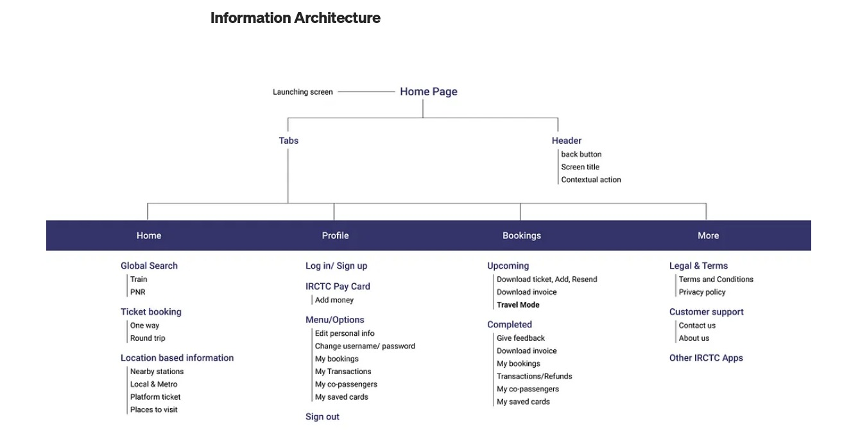
Sitemap
6
4
2
5
1
3

Slide 6
Consumptions of IRS
Resource Consumption Overview:
During the migration of the Indian Railway System (IRS) to AWS, various resources are essential to support the transition and ongoing operations.
This section will provide insights into three crucial resource areas:
Bandwidth
Storage
processing requirements.
6
2
5
1
3
4

Slide 7
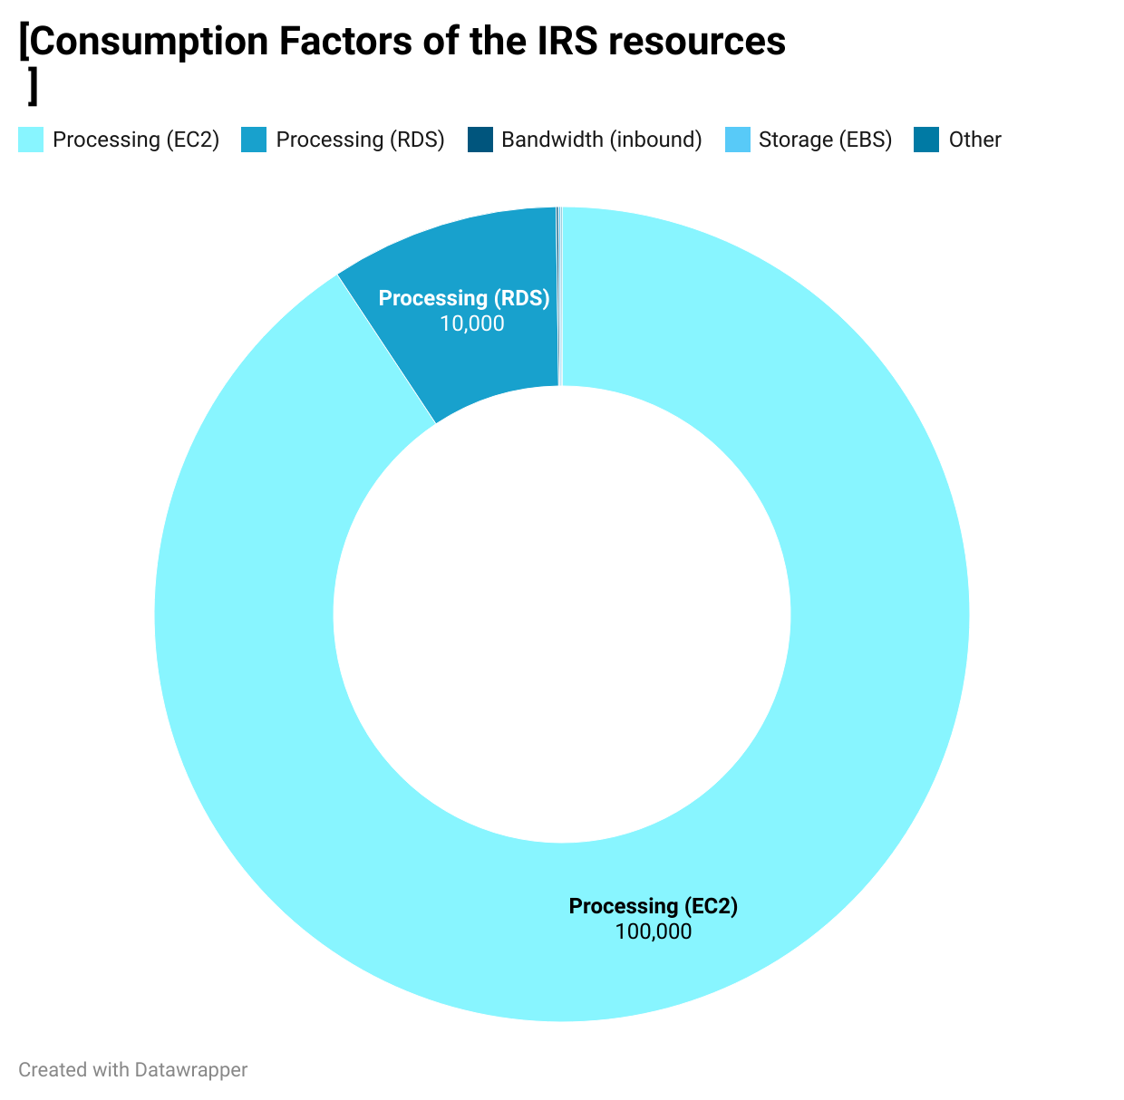
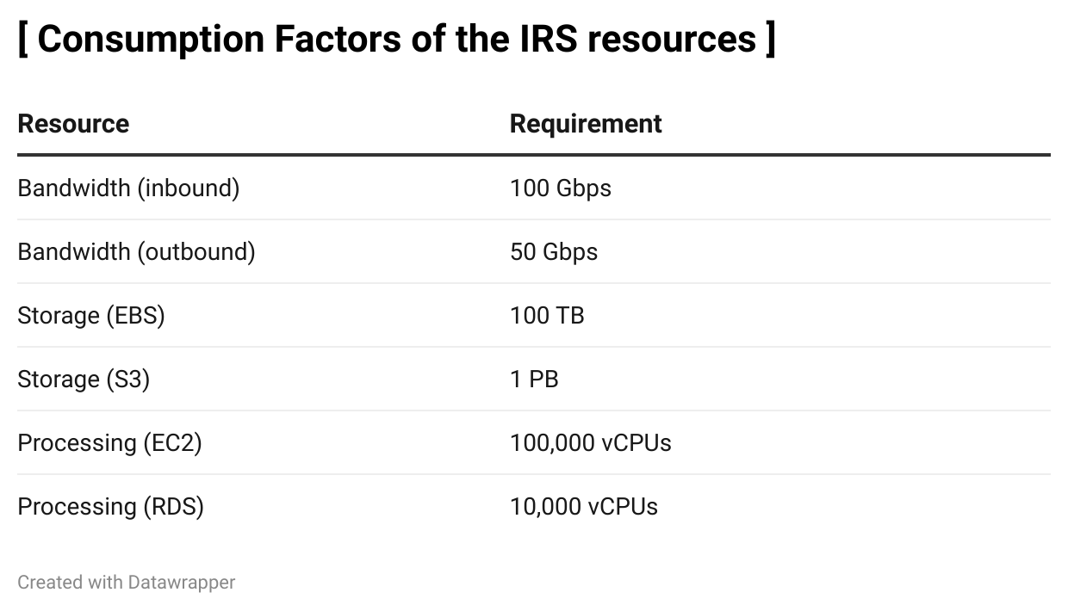
Consumptions of IRS
Resource Consumption Summary:
Current Consumption:
Bandwidth: 150 Gbps (Inbound: 100 Gbps, Outbound: 50 Gbps).
Storage: 1.1 PB (EBS: 100 TB, S3: 1 PB).
Processing: 110,000 vCPUs (EC2: 100,000, RDS: 10,000).
6
2
5
1
3
4

Slide 8
Architecture Diagram
Three-Tier Architecture Model for IRS Migration to AWS:
Application Tier:
Utilizes Amazon EC2 instances for scalability, availability, security, and cost efficiency.
Database Tier:
Relies on Amazon RDS for scalability, availability, security, and cost efficiency.
Storage Tier:
Leverages Amazon S3 for scalability, availability, security, and cost efficiency.
6
2
1
3
4
5

Slide 9
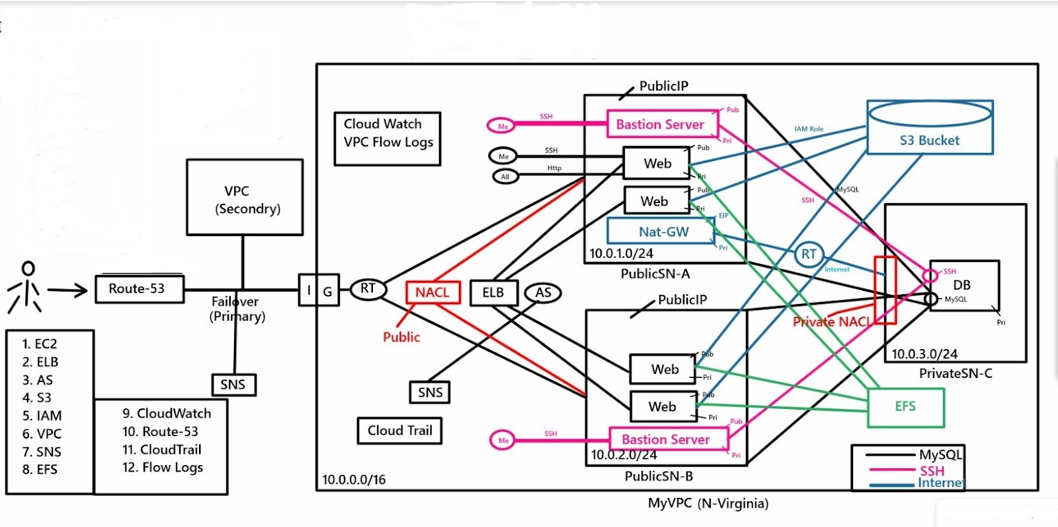
Architecture Diagram
6
2
1
3
4
5

Slide 10
Conclusion
The successful migration to AWS significantly enhances the Indian Railway System (IRS), resulting in improved performance, reduced operational costs, and a highly reliable transportation network for both passengers and freight. The implementation of robust security measures ensures the protection of sensitive data and operations, while cost-efficient AWS pricing options contribute to substantial overall savings.
2
1
3
4
6
5

Slide 11


